Slide 1
Musical instrument detection with deep learning
DSR Batch #21

Slide 2
Models
Convolution 2D - “imagified” waveform analysis
Convolution 1D - “direct look” at the waveform
Transfer learning - selecting features from a pretrained network
Multiheaded network: multiple inputs (different shapes and sizes) -> single output

Slide 3
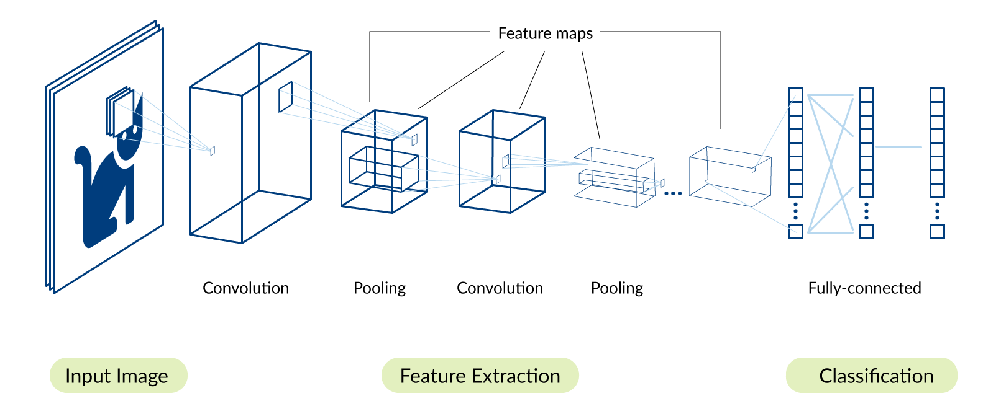
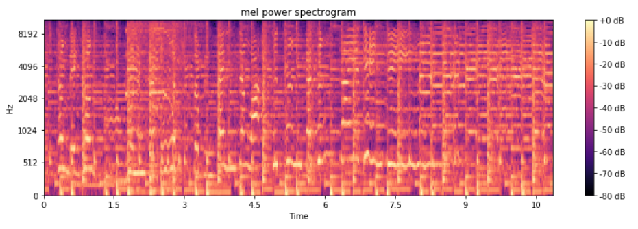
Convolution 2D - a visual representation

Slide 4
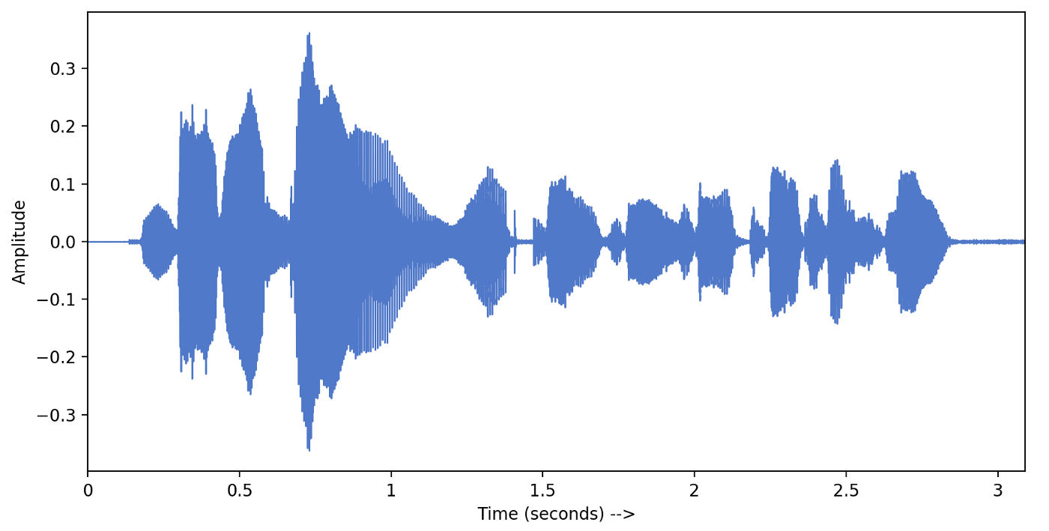
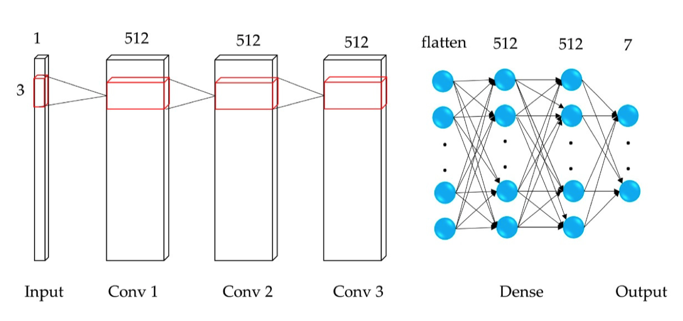
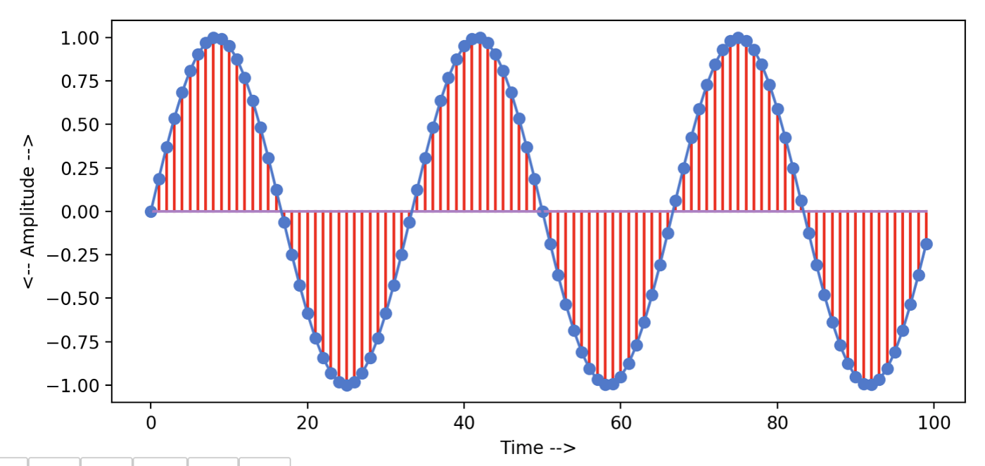
Convolution 1D

Slide 5
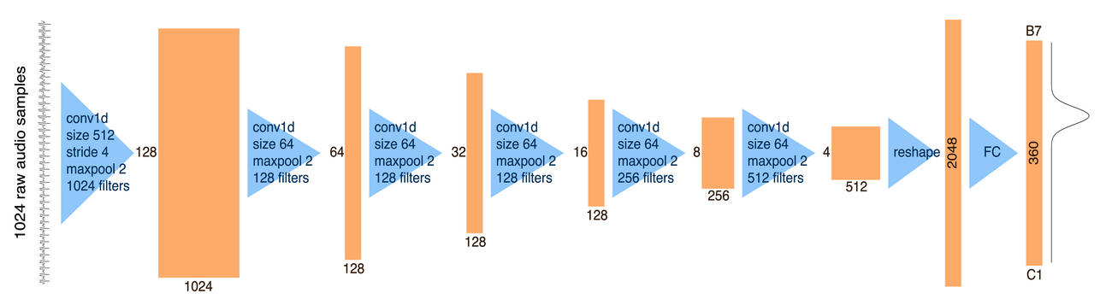
Transfer learning
CREPE: A Convolutional Representation for Pitch Estimation https://arxiv.org/abs/1802.06182

Slide 6

Hydra
3-Headed network
Convolution 1D + Convolution 2D + Convolution 2D
RNN at the end for the fun
Looks good and is satisfying with complexity
Results are not adding up in a linear way

Slide 7
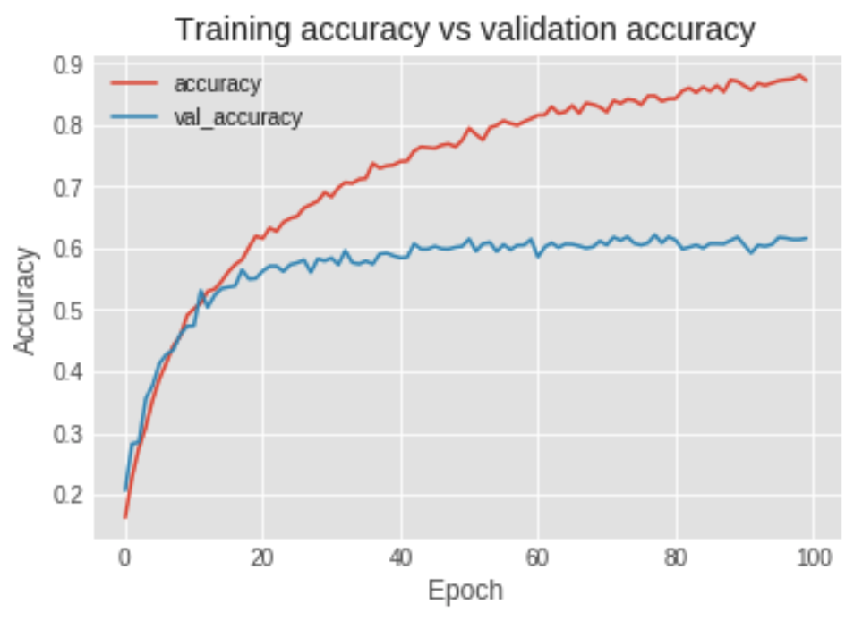
Models summary
Over 60% percent accuracy limit on 4200 samples with 11 classes on the IRMAS dataset
1D Convolution is surprisingly accurate (though slower), approaching 55% accuracy on the same set
“Classic” way of training with spectrograms works fastest
Dataset is more important than complex network architecture

Slide 8
Things to try
Differentiable layers in Keras (On-GPU feature generation, filtering) - Kapre
Multi-model prediction
Advanced augmentation techniques (effects, mixing instruments)
Autoencoders
Depthwise separable convolution
Multiple instrument detection

Slide 9
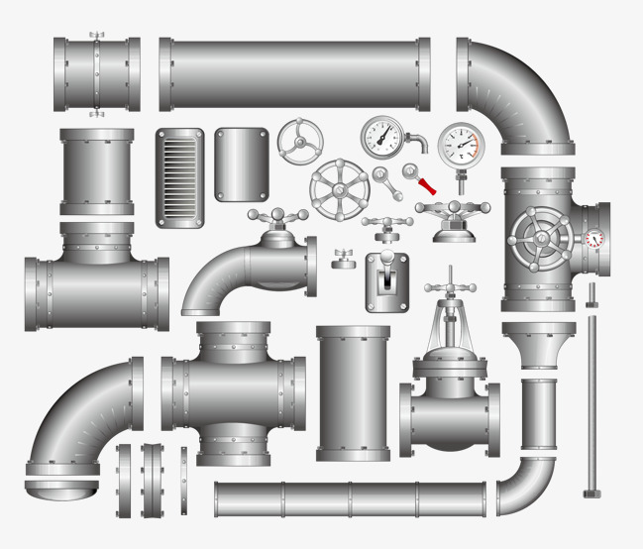
Lessons learned
Pipeline is important
Split the data (train/validation/test) early
Amount of data is important (augmentation helps)
Multiprocessing can be tricky
Early test by ear/eye, metrics can be deceiving
There are no clear answers in Deep Learning

